Slide 1

Nutrient availability increases leaf nitrogen at the expense of whole plant growth in a closed canopy temperate forest
Evan A. Perkowski¹; David W. Frey²; Christine L. Goodale²; Nicholas G. Smith¹
¹Dept. of Biological Sciences, Texas Tech University
²Dept. of Ecology and Evolutionary Biology, Cornell University

Slide 2
Soil resource availability
Leaf nutrient content
Photosynthetic capacity
Leaf-level photosynthesis
Terrestrial biosphere models indirectly predict photosynthetic capacity from soil nitrogen availability
Notes:
Many terrestrial biosphere models, which are the land surface component of Earth system models, predict leaf-level photosynthesis via this diagram
Terrestrial biosphere models commonly predict leaf-level photosynthesis via relationships between leaf nutrient content and photosynthetic capacity.
However, leaf nutrient content is often predicted by soil resource availability,
Which means that TBMs indirectly predict photosynthetic capacity and leaf-level photosynthesis from soil resource availability
Soil resource -> leaf nutrient content (Firn et al. 2019): NutNet meeting July 2021
Set up differently (options)
We don't really have a good grasp of what leaves are doing (we don't have photosynthetic data in the field)
A few meta-analyses, but not a ton of data (photosynthesis)
Add extra bit about when and where it might be better to do what option (option 1: dry system); (option 2: open canopy vs. closed canopy)

Slide 3
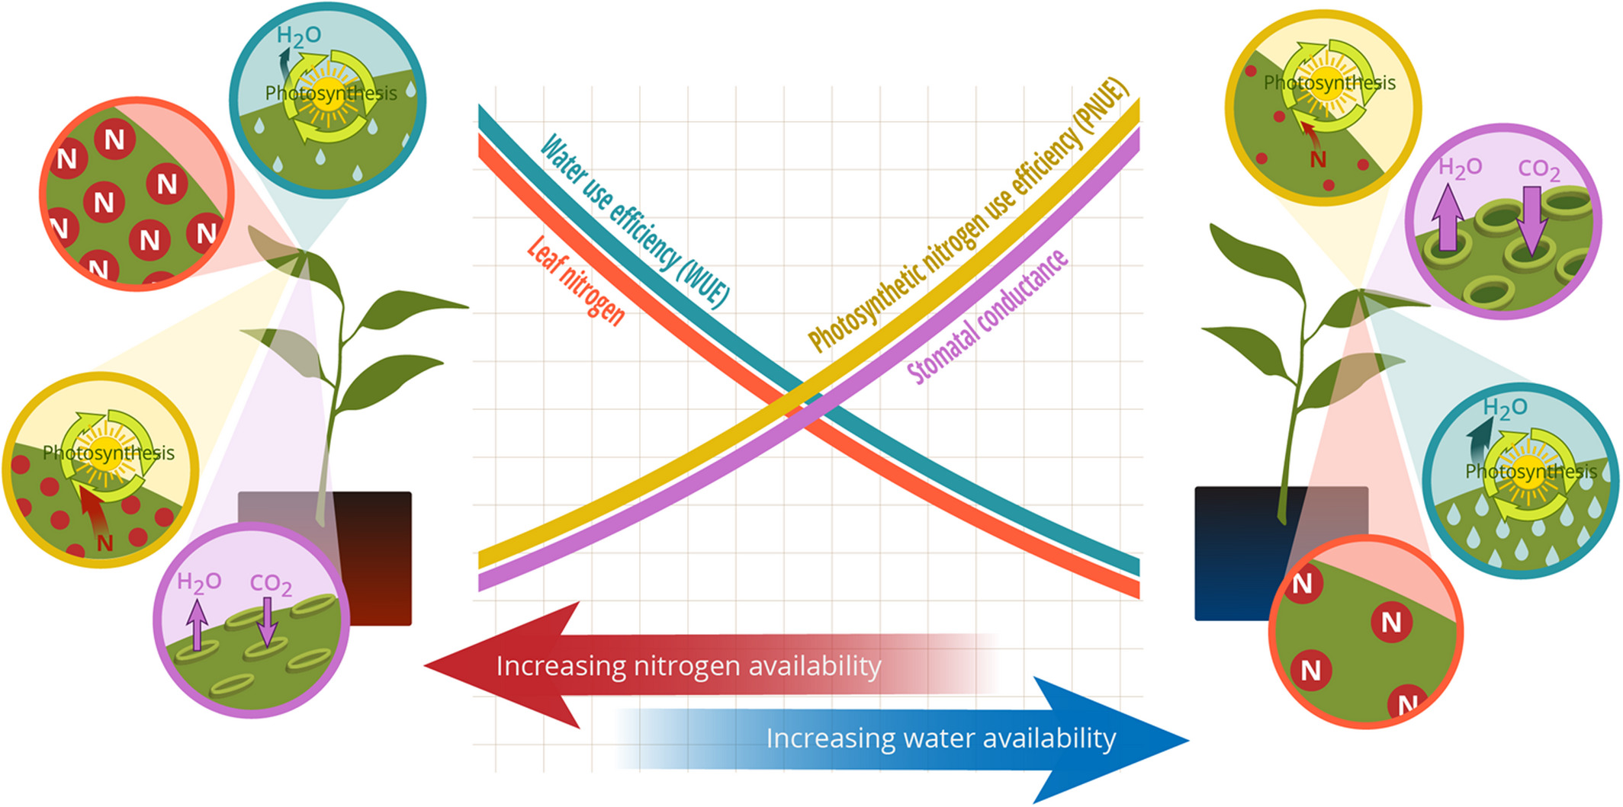
Option #1: Maintain photosynthesis with greater water-use efficiency at expense of photosynthetic nitrogen-use efficiency
Bialic-Murphy et al. (2021) Ecol. Letters
Notes:
There are two hypothetical options that could explain where nitrogen is going if not toward leaf-level photosynthesis
The first option is to allocate nitrogen to photosynthetic leaf tissue based on tradeoffs between nitrogen and water availability.
This option is predicated on recent optimality frameworks suggesting that plants can and should trade efficient use of an abundant resource for a more limited limiting resource.
For example, if nitrogen is relatively more available than water, then plants can maintain a similar photosynthetic output by increasing nitrogen allocation toward photosynthetic leaf tissue in order to increase water-use efficiency.
Alternatively, if water is relatively more available than nitrogen, then the opposite may occur, where plants increase stomatal conductance to increase water movement and allow similar photosynthetic outputs at higher nitrogen-use efficiency and lower water-use efficiency.

Slide 4
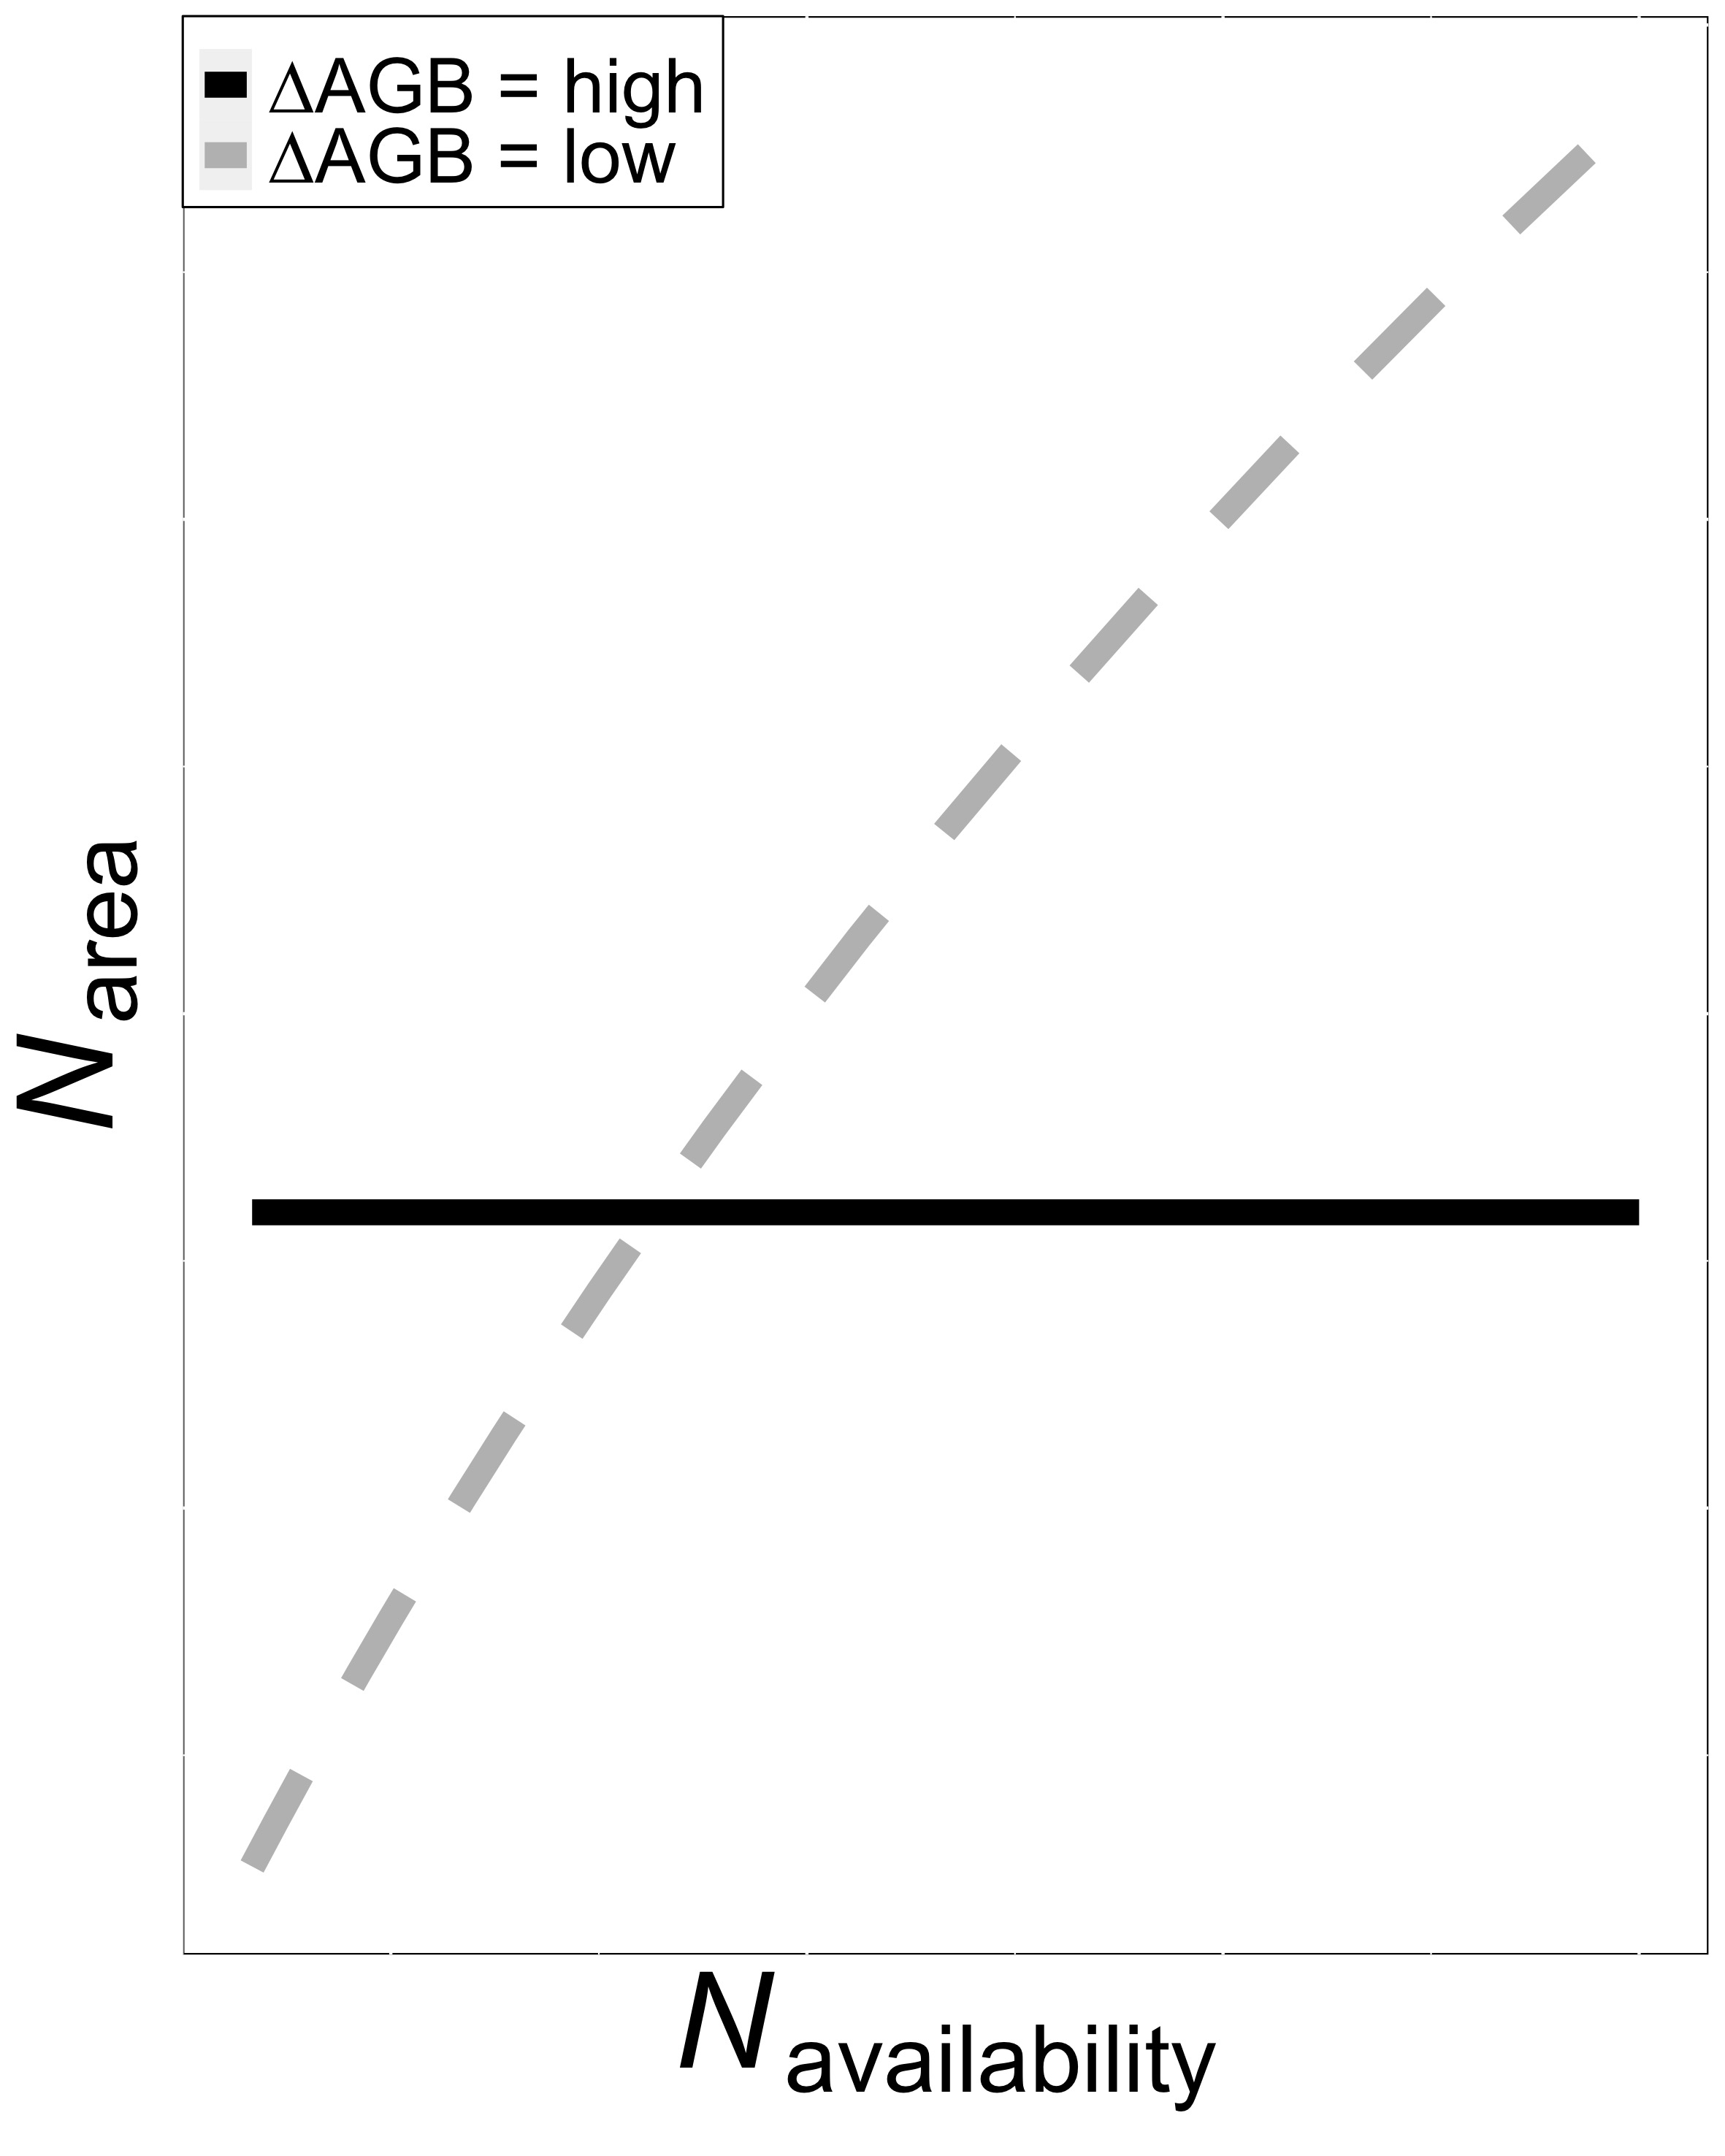
Option #2: Invest extra nitrogen toward whole plant growth at expense of leaf nitrogen, or vice versa
Smith et al. (in prep)
Notes:
The second option is to allocate nitrogen to photosynthetic leaf tissue based on tradeoffs between leaf-level nitrogen demand and whole plant nitrogen demand.
In other words, if plants invest extra nitrogen toward whole plant growth, then this should come at the expense of leaf nitrogen.
This could be indexed through nitrogen investment in leaf quantity over quality, or toward maintenance of structural tissue essential for the survival and reproduction of an individual

Slide 5
Very few manipulative studies investigate leaf and whole plant responses to changes in soil nutrient availability
Notes:
To date, effects of soil nutrient availability on tradeoffs between leaf quality and leaf quantity or between nitrogen and water usage have been investigated using broad environmental gradients.
However, no study to date has investigated these patterns through a direct soil nutrient addition experiment

Slide 6
Study Question
How do leaf and whole plant processes respond to soil nutrient availability in a closed canopy system?
Notes:
So, using the hypotheses explained in the two options before, we wanted to know how leaf and whole plant processes responded to a soil nutrient addition experiment.

Slide 7
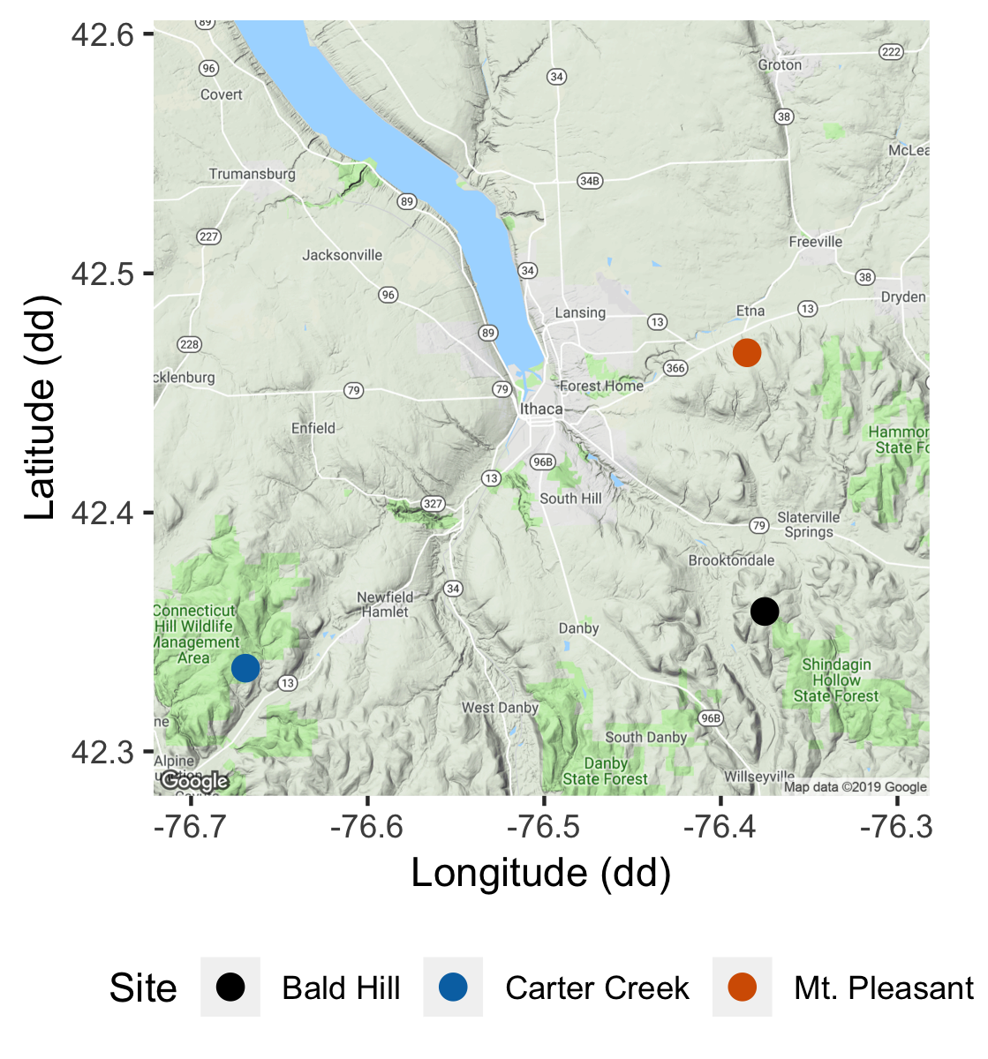
Study system
Soil fertilization treatments
Sites
0 kg ha⁻¹ yr⁻¹ N; 0 kg ha⁻¹ yr⁻¹ S
Bald Hill
0 kg ha⁻¹ yr⁻¹ N;
57 kg ha⁻¹ yr⁻¹ S
Mount Pleasant
50 kg ha⁻¹ yr⁻¹ N;
0 kg ha⁻¹ yr⁻¹ S
Carter Creek
50 kg ha⁻¹ yr⁻¹ N; 57 kg ha⁻¹ yr⁻¹ S
Notes:
We used the following field manipulation experiment to investigate whether changes in soil resource availability influenced leaf quantity/quality tradeoffs or water/nitrogen use tradeoffs.
Starting in 2010, our coauthor Christy Goodale set up a full-factorial nitrogen-by-sulfur field manipulation experiment at three sites all within a 20-km radius of Ithaca, New York
This experiment was originally created to tease apart the impacts of soil pH change and soil nitrogen fertilization on forest systems;
however, because sulfur additions acidify the soil and promote nitrogen losses over time, this system provides a unique soil nitrogen availability gradient to test our hypotheses.

Slide 8
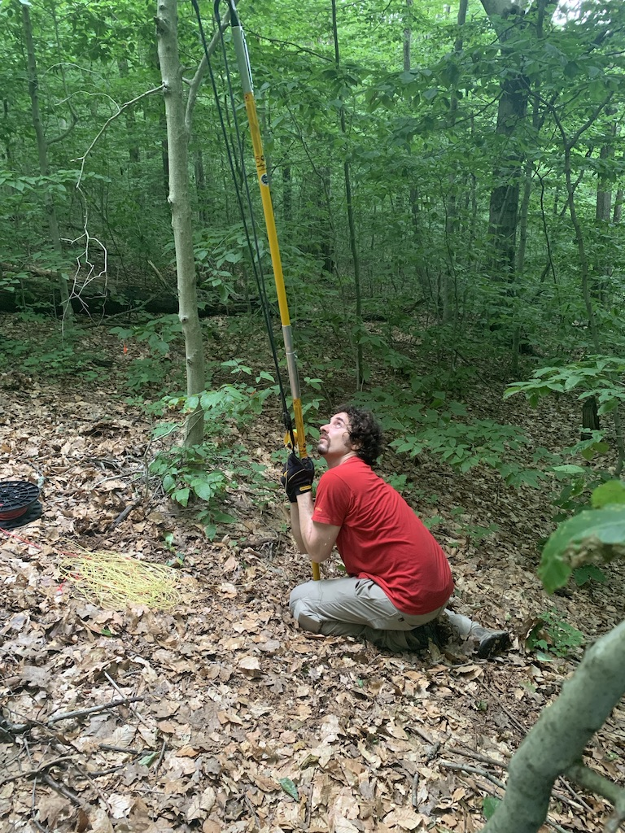
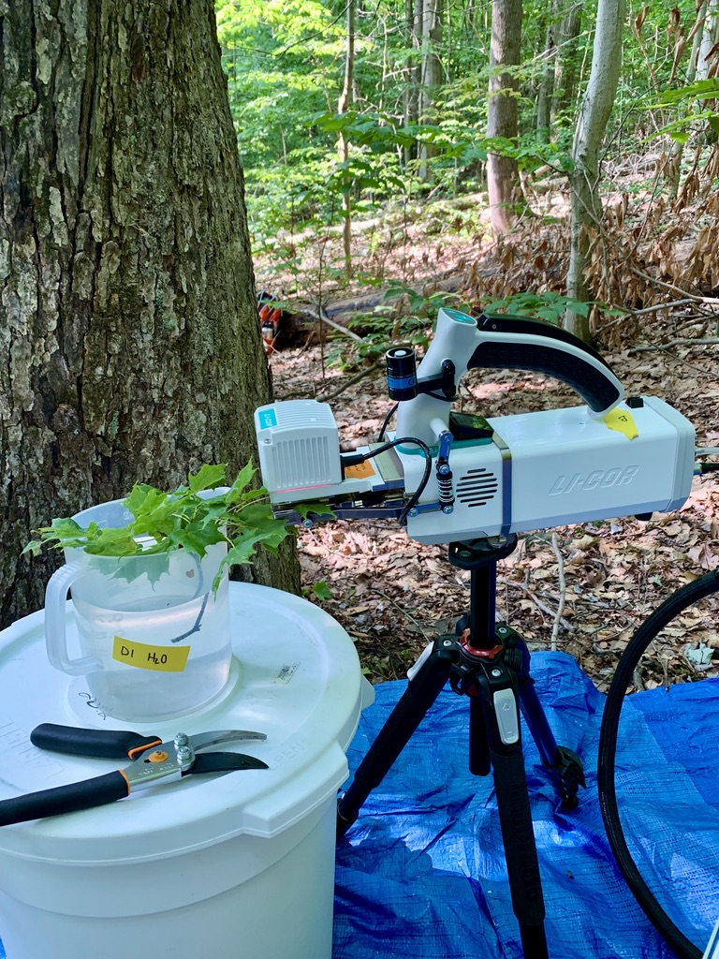
Leaf sampling
Fully sunlit canopy leaves brought down with arborist’s slingshot
Branches recut underwater
CO₂ response curve using LI-COR 6800
Notes:
We collected fully sunlight canopy leaves from each of the plots using an arborist’s slingshot and used a LI-COR 6800 to measure carbon dioxide response curves

Slide 9
Plant measurements
Leaf-level measurements
Whole plant measurements
Net photosynthesis and biochemical process rates
Leaf nitrogen per unit leaf area
Foliar δ¹³C (water-use efficiency proxy)
PNUE/iWUE
Change in basal area between 2011 and 2019
Relative growth rate using allometrically-scaled whole tree biomass
Notes:
In addition to net photosynthesis and biochemical process rates, we also quantified leaf nitrogen per unit leaf area and foliar d13C.
We also quantified photosynthetic nitrogen-use and intrinsic water-use efficiency.
At the whole plant level, we calculated the change in basal area between 2011 and 2019 to get an estimate of woody tissue production and estimated relative growth rate between the same years using allometrically-scaled biomass data

Slide 10
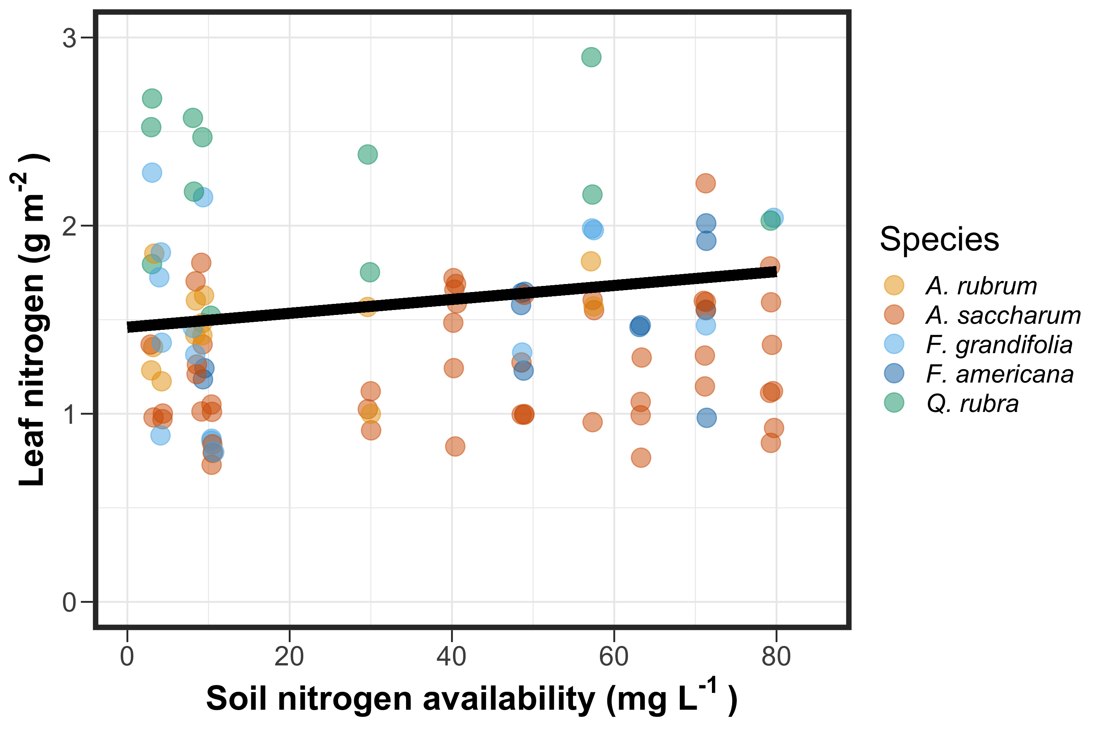
Soil nitrogen availability increases leaf nitrogen

Slide 11
Soil nitrogen availability increases leaf nitrogen

Slide 12
Soil nitrogen availability increases photosynthetic capacity

Slide 13
Soil nitrogen availability increases photosynthetic capacity

Slide 14
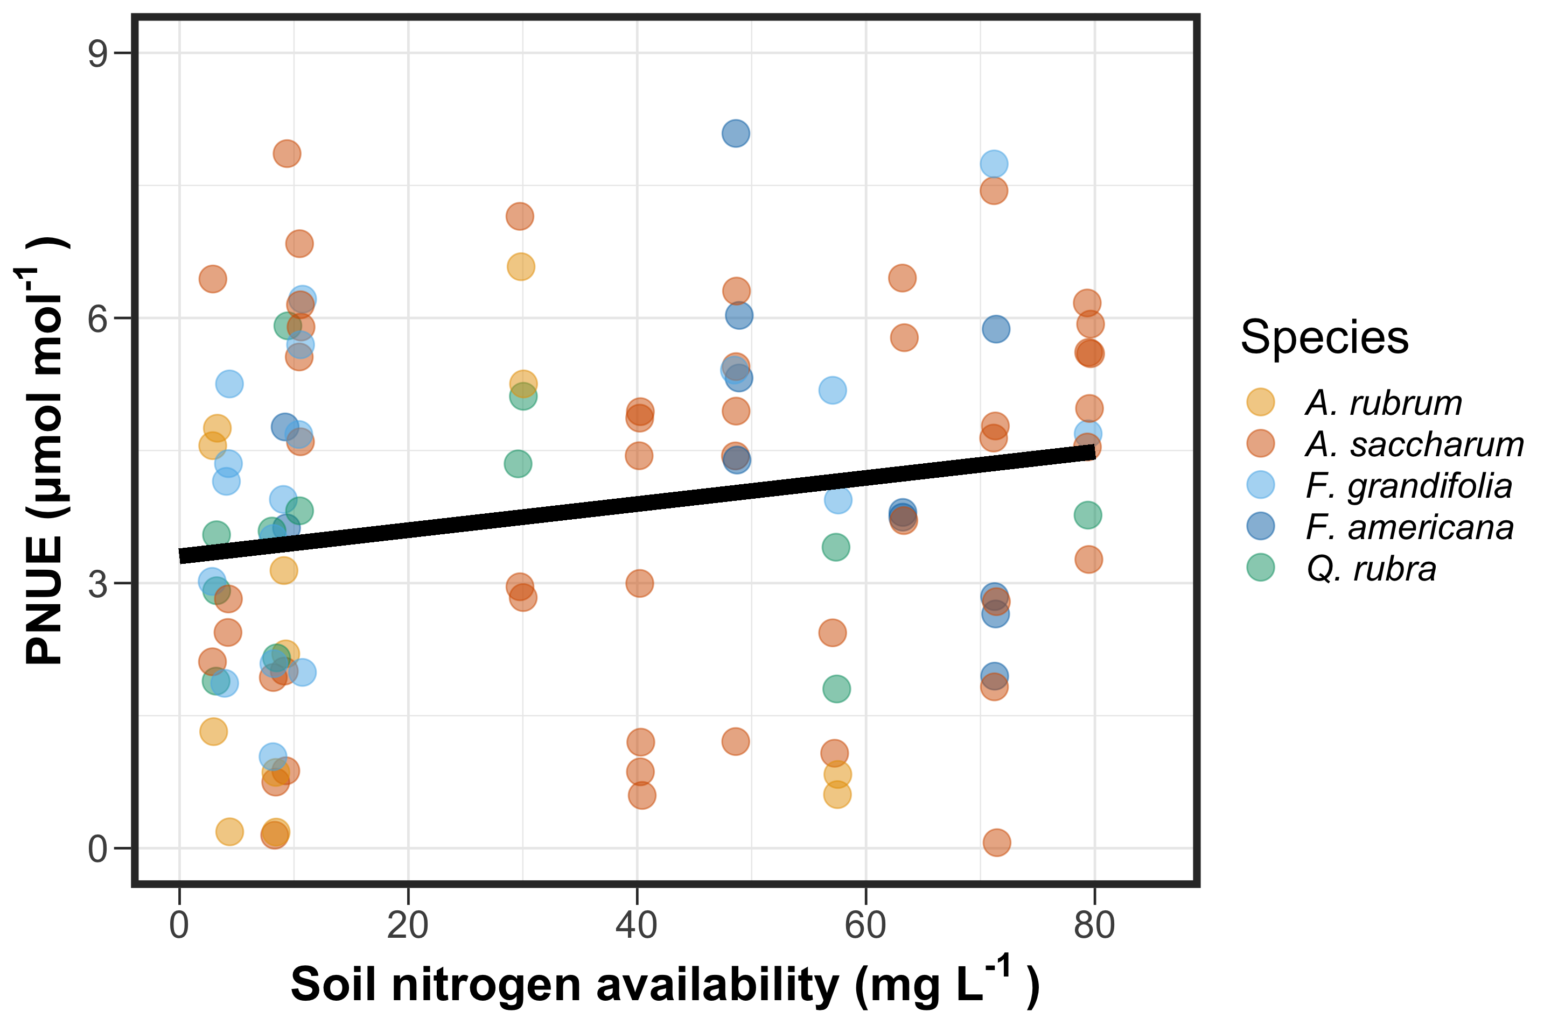
Soil nitrogen availability increases photosynthetic nitrogen-use efficiency…
Notes:
Interestingly, increases with leaf nitrogen per unit leaf area corresponded with an increase in photosynthetic nitrogen-use efficiency
However, this did not correspond with a change in intrinsic water-use efficiency
Put in hypothesized pattern before revealing figure

Slide 15
Soil nitrogen availability increases photosynthetic nitrogen-use efficiency…
Notes:
Interestingly, increases with leaf nitrogen per unit leaf area corresponded with an increase in photosynthetic nitrogen-use efficiency
However, this did not correspond with a change in intrinsic water-use efficiency
Put in hypothesized pattern before revealing figure

Slide 16
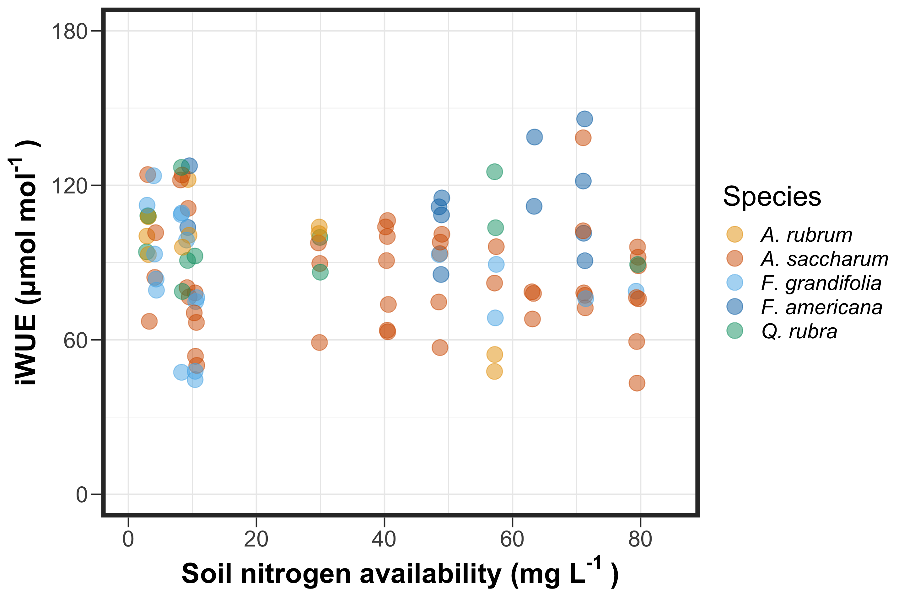
… but does not influence water-use efficiency
Notes:
Interestingly, increases with leaf nitrogen per unit leaf area corresponded with an increase in photosynthetic nitrogen-use efficiency
However, this did not correspond with a change in intrinsic water-use efficiency
Put in hypothesized pattern before revealing figure

Slide 17
… but does not influence water-use efficiency
Notes:
Interestingly, increases with leaf nitrogen per unit leaf area corresponded with an increase in photosynthetic nitrogen-use efficiency
However, this did not correspond with a change in intrinsic water-use efficiency
Put in hypothesized pattern before revealing figure

Slide 18
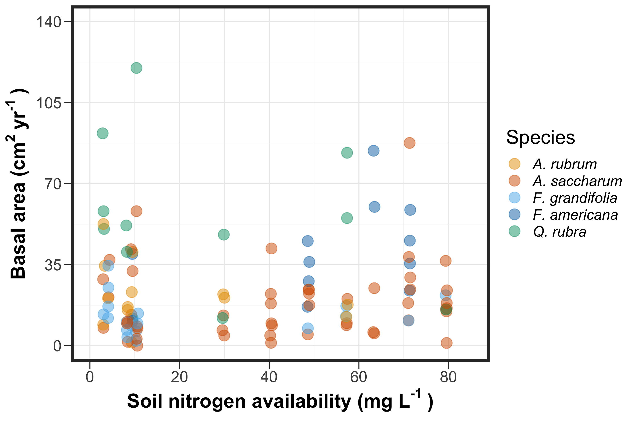
Soil nitrogen availability does not influence woody tissue production…
Notes:
Increases in leaf-level photosynthesis did not correspond with increases in whole plant growth.
This was observed for both whole plant growth metrics, where soil nitrogen availability did not affect the relative change in basal area, or relative growth

Slide 19
Soil nitrogen availability does not influence woody tissue production…
Notes:
Increases in leaf-level photosynthesis did not correspond with increases in whole plant growth.
This was observed for both whole plant growth metrics, where soil nitrogen availability did not affect the relative change in basal area, or relative growth

Slide 20
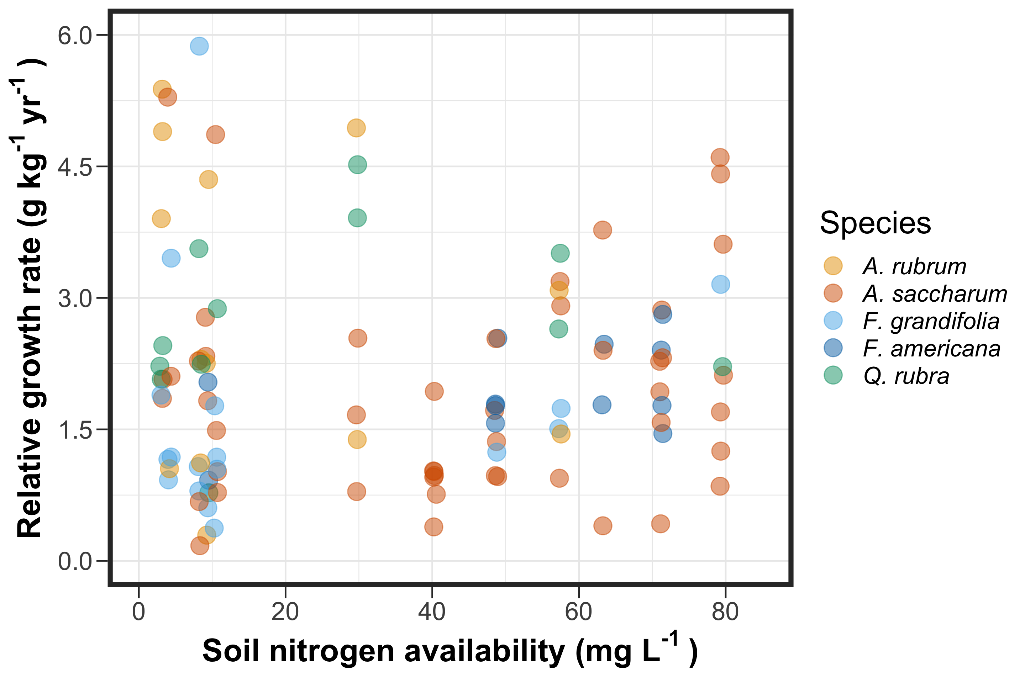
… or relative growth rate

Slide 21
… or relative growth rate

Slide 22
Revisiting Option 1
Did soil N allow photosynthesis rates to be achieved with higher water use efficiency at the expense of nitrogen-use efficiency?
Bialic-Murphy et al. (2021) Ecol. Letters

Slide 23
Revisiting Option 1
Did soil N allow photosynthesis rates to be achieved with higher water use efficiency at the expense of nitrogen-use efficiency?
No, increased soil N increased nitrogen-use efficiency and did not influence water-use efficiency
Bialic-Murphy et al. (2021) Ecol. Letters

Slide 24
Revisiting Option 2
Did soil N invoke tradeoffs between biomass production and N_{area}?
Smith et al. (in prep)

Slide 25
Revisiting Option 2
Did soil N invoke tradeoffs between biomass production and N_{area}?
Yes! Soil N did not influence whole plant growth, but increased N_{area}.
Smith et al. (in prep)

Slide 26
Discussion
[work in progress]
Notes:
Light availability over a day/week- what degree of photosynthetic stimulation you get with Jmax:Vcmax
- How much added carbon assimilation is happening
acclimating to highest light point of day

Slide 27
Acknowledgements
USDA NIFA Award 2015-67003-23485
Texas Tech University
Risa McNellis (TTU)
Omair Irfan (Cornell)
Romin Abdolahzadi (Cornell)
Members of Schwilk & van Gestel labs (TTU)
Dr. Lizz Waring (TTU)
Notes:
Abdola-zadi

Slide 28
Thank you!

